Slide 1

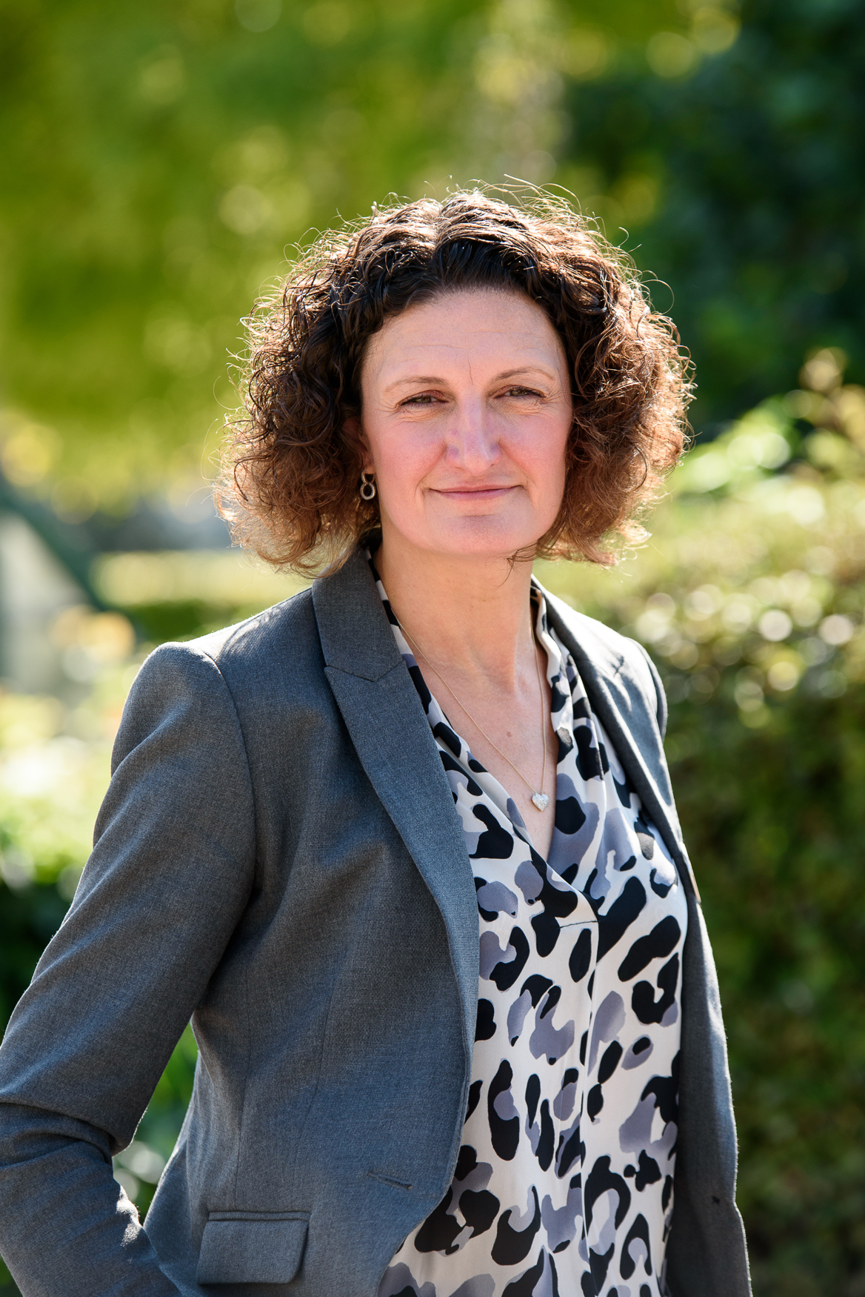




Weekly Newsletter
19th September 2025
Welcome to this week’s newsletter.
During the month of September we will be focussing on the values of Dedication and Independence. Dedication is defined as giving lots of time and energy to things that are important. Independence is explained as trying new things on your own. This week’s assembly was an opportunity to celebrate Roald Day, which was on the 13th September and teach the children about his dedication to the world of children’s literature.
The term is now underway and it is an opportunity to make you aware that our main school priority this year is to raise standards in children’s writing. In order to do this we have introduced the I Am A Clever Writer programme. This programme is designed to develop children’s handwriting, spelling and independent writing. If your child is in years 1-6 they may have come home and spoken about a WAGOLL! This acronym refers to how the writing lessons of the week begin with a piece of writing that demonstrates What A good One Looks Like (WAGOLL). If you would like to know more about this writing programme please search for them on Facebook and Instagram.
Alongside this, we are also continuing to focus on every child
being a confident reader. Your child will be coming home
with their reading books and we do ask that daily reading is part
of their routine. If you do require any support with your child’s
reading please speak to the class teacher.
Mrs Kelly
Headteacher
Our values ambassadors
Find more
RW- Jack
RS- Hiba
1G- Lucas
1T- Yaman
2G- Lily-Rae
2M- Raheem
3M- Sahib
3R- Ripnaaz
4H- Abel
4D- Mason
4C- Jack
5M- Amira
5N- Vinayak
6B- Riley
6D- Sebastian
Nursery- Maryann
Facebook
Independence
Instagram
Website
Charville Academy is not responsible for the content of external websites.

Slide 2
Reception Parent/ Carer Lunch
If you child is in Reception you are invited to school on Friday 26th September to have lunch in the Dining Room with your child. This is limited to one adult per child. If you are unable to attend, your child can be joined by another relative of your choice.
Please complete the Google Form that was issued this week so that we can understand how many adults will be joining us and what you would like for lunch.
Pink Day- Remembering Miss Bristow
On Friday 26th September it is Pink Day in memory of Miss Bristow.
Please make your donation via Parentpay and your child can come to school in their own clothes with a splash of pink.
At the end of the day their will be a pink themed cake sale. Please send in your donations by Thursday 25th September. We will be accepting cash only at the sale.
Governor Vacancies – we need your help
We currently have two Parent Governor vacancies on our board of governors. Governors play a vital role in school development and support the Headteacher and others to ensure the school continues to develop.
If you are interested in this role please see the letter issued this week. If you would like more information please email office@charvilleacademy.org
We are also looking for Community Governors to join the board. These are community members who are not parents of the school. If you know of anyone who maybe interested please pas on the office email address.

Slide 3
Key dates
These are the current dates for
Autumn term 1
26th Sep – Pink Day
29th Sept - After school clubs commence
23rd Oct – School Discos
24th Oct - Training day, school closed to children
27th – 31st Oct - Half term
3rd Dec - Winter Wonderland
19th Dec – End of term, School closes at 1.30pm
CURRICULUM BOOKS / HOME LEARNING LETTERS
The curriculum booklets for the Spring term and the Home Learning Policy are on the website. Please follow the links to access them:-
https://www.charvilleacademy.org/page/?title=Curriculum+Booklets&pid=124&action=saved
Whole school Attendance this week is 92.65%
Well done to 4C and 6D who got above 98%
Letters/emails home this week
Remembering Miss Bristow – Whole School
Instrumental lessons - KS1/KS2
Please also see the flyer attached from The Brook house FC- good luck to our very own Mr Pender.

