Slide 1

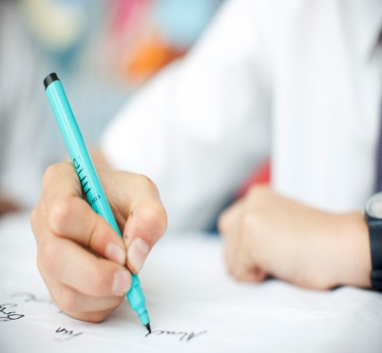
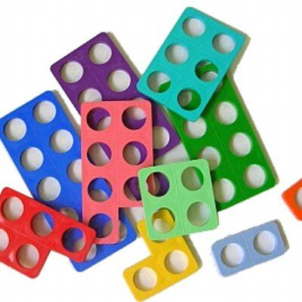
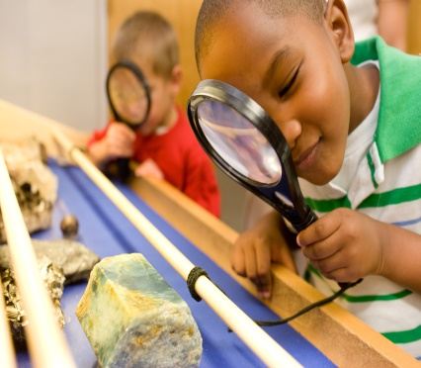
Curriculum Booklet
Blue, Yellow & Green Hub – Autumn
2025 - 2026
English
This term all Hubs, in line with the rest of the school, will be following the ‘I am a Clever Writer’ approach for improving our writing skills. All skills will be supported with a variety of books.
For Blue Hub, this will involve developing the correct pressure, finger/hand exercise and pencil control.
For Yellow Hub, this will involve developing pencil control, forming letters correctly and writing words.
For Green Hub, this will involve improving the prewriting skills and beginning to independently build simple and more complex sentences.
Maths
The children in all Hubs will focus on a range of mathematical concepts based on their understanding.
Blue Hub will primarily focus on sorting & matching the number 1-5 and will be introduced to a variety of shapes.
Yellow Hub will focus on include ordering numbers to 10, writing numbers and identifying one and lots of given objects.
Green Hub will focus on numbers to 100 or 1000 and addition within 100. The children will use a variety of manipulatives to support this.
Science
Blue Hub will be focusing on their senses and their body before moving on to looking at the weather and seasons.
Yellow Hub will explore animals including humans
Green Hub - As scientists,the children in Green Hub will be focusing on ‘How do plants stay alive?’. We will explore the different things a plant needs to grow. In addition, the children will conduct an experiment relating to this to show the effects of growing.

Slide 2
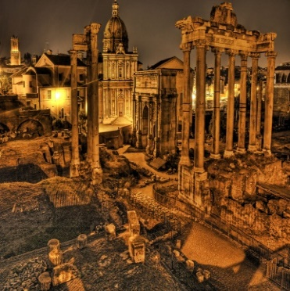
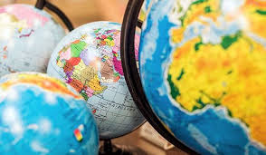
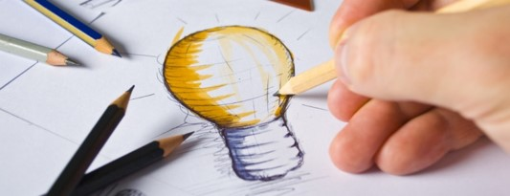
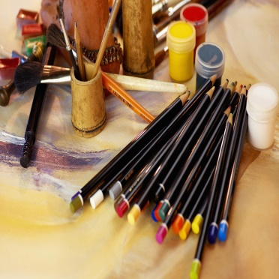
History
As Historians, the children in Green Hub will be focusing on ‘How did WW1 change Britain?’. The children will begin by focusing on the start of WW1 and how this began. The children will then use images to explore the different changes that were seen in Britain during the war.
Geography
Yellow Hub - As Geographers, Yellow Hub will focus on
‘How do we record the weather?’. The children will observe and look at different images of weather. They will then work on identifying this weather using symbols.
Green Hub - The children will begin exploring rainforests. The children will explore what a rainforest is, before looking at the different features. Finally, the children will explore why rainforests are important.
D&T
DT this half-term will focus on cooking and preparing different food items. This will link directly to our Life-Skills learning.
Art
Yellow Hub - In Art, the children are focusing on sculptures. The children will explore creating shapes using clay and dough. THe children will then use this to create different sculptures based on an object of their choice.
Green Hub - The children in Green Hub will be focusing on using a range of different media in their lessons to recreate famous pictures. The children will explore a number of paintings and their artists before recreating them.

Slide 3


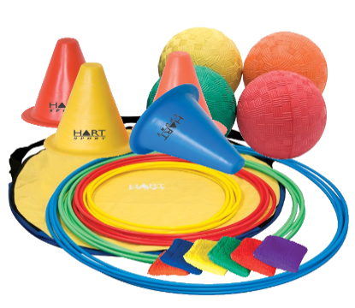
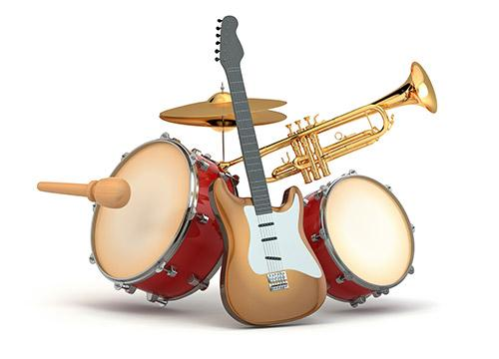
RE
In RE, the children will be exploring ‘Special People’. We will explore the different special people in their lives before exploring different key people from various religions including Jesus. We will explore the significance of these and link them to special people in the children’s lives.
Computing
Green Hub - In Computing, the children will explore how to use a keyboard ot write various sentences. The children will focus on using the keyboard and mouse independently. We will be introducing keys such as shift to allow the children to include capital letters into their sentences.
PE
In PE, Yellow Hub are working on fundamental movement skills. Working with the adults they will work on movements such as running, jumping, balancing, throwing and catching.
Music
Yellow Hub - In Music, the children are working on recognising different beats and tempos, The children are enjoying exploring different music and making movements to this.
Green Hub - The children are learning about different types of music and learning how to make music along with a beat.

Slide 4

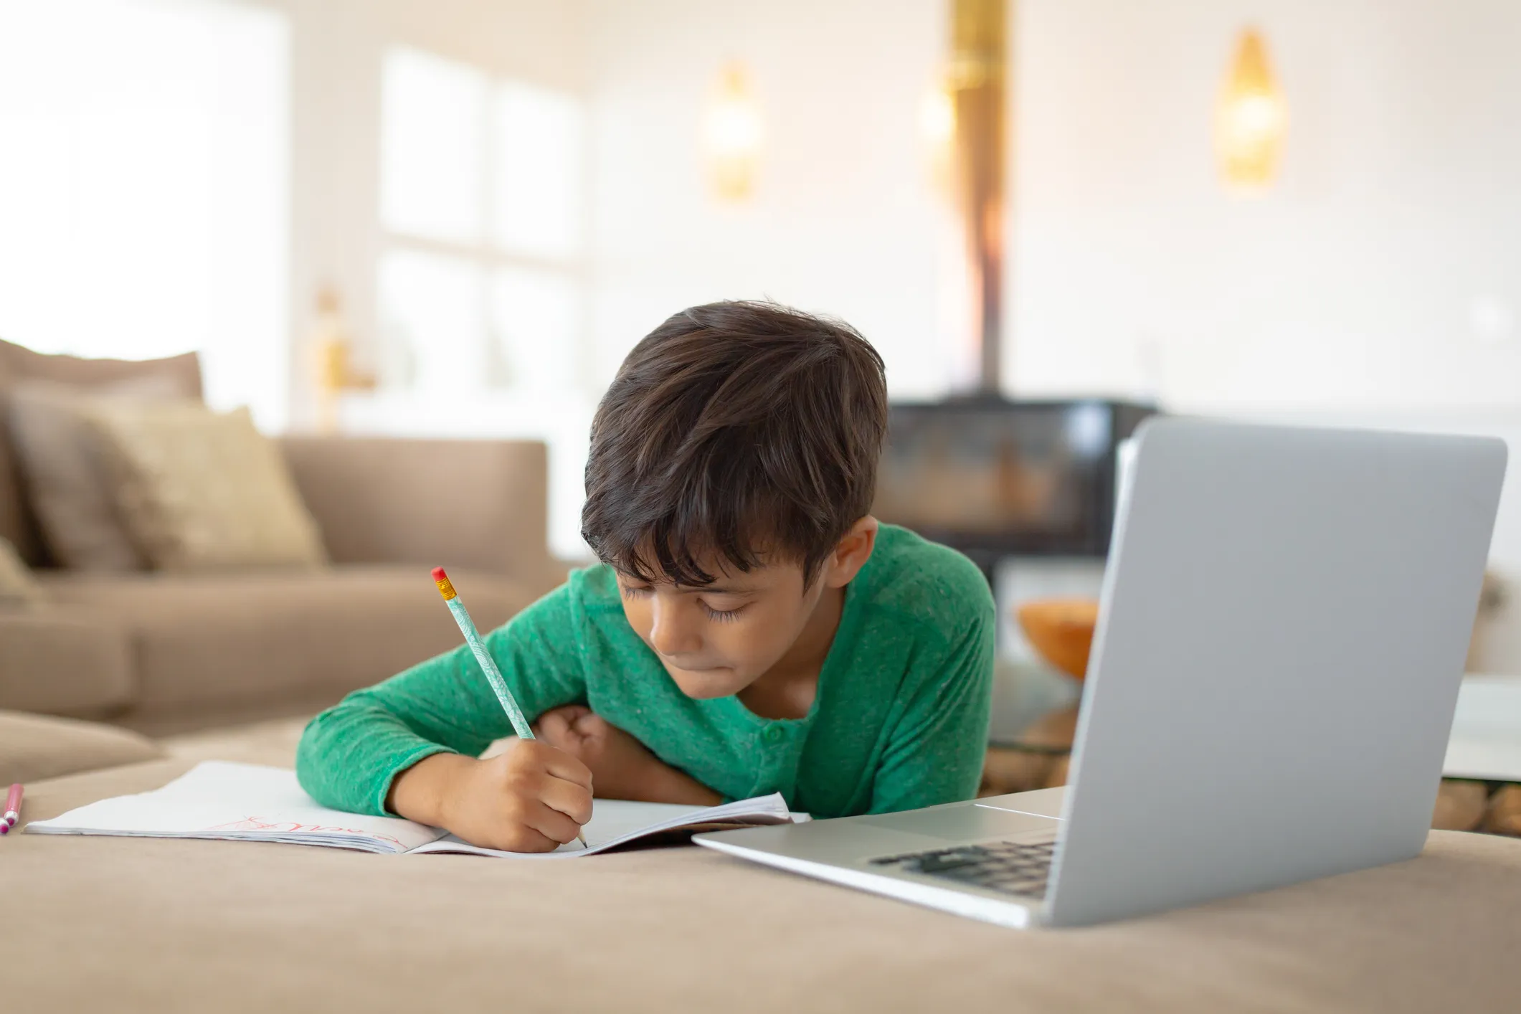
Life Skills
Life Skills will allow all of the children in The Hub to focus on different skills which will benefit their independence. This includes dressing, cooking and being in the local environment. The children will travel to places such as local parks and the shops. Children will also prepare a number of meals following a recipe.
Home Learning
Home Learning this term will include weekly reading. In addition, the children will be provided with one piece of work which is based on their learning throughout the week. This will be individually set to ensure that a child is able to access this at home.

