Slide 1

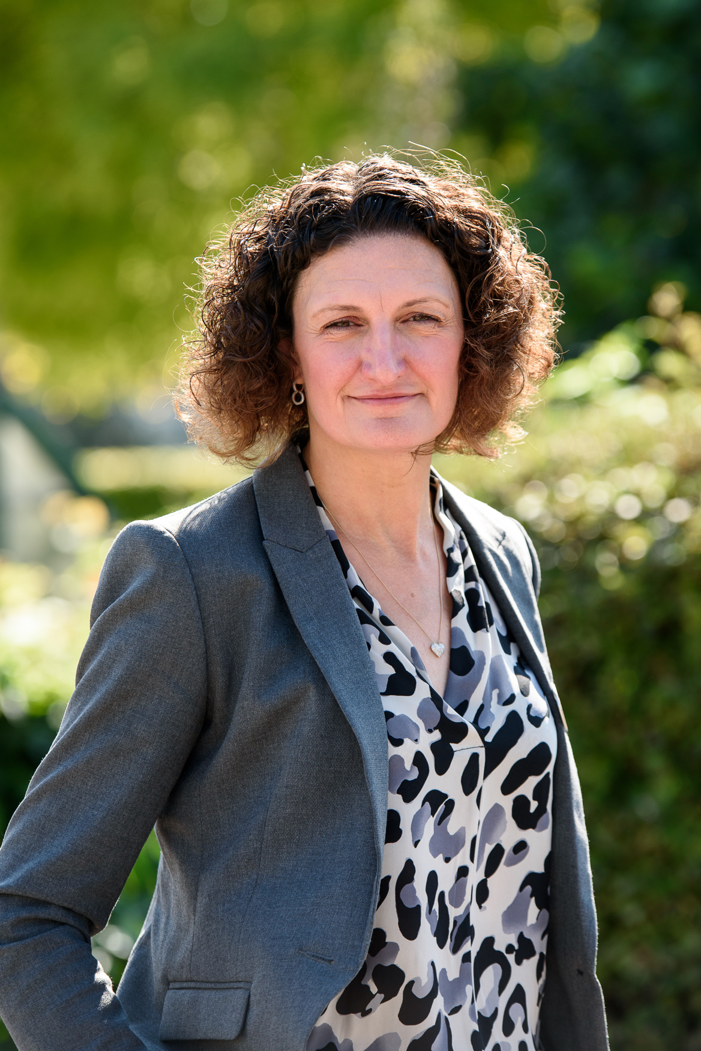




Weekly Newsletter
^{8th May 2026}
Welcome to this week’s newsletter.
I would like to start by saying thank you to those that have already sponsored the staff who taking part in Race for Life in loving memory of Miss Bristow. If you would like to donate please follow this link; all money raised goes straight to Cancer Research:
https://fundraise.cancerresearchuk.org/team/charville
We ask that all parents of children in Years 1-5 ensure that their child has gone through the gates in the morning before you leave. This does not apply to Nursery and Reception as we know you bring your child to the classroom door.
Next week is SATs week in Year 6. All children need to be in school everyday and on time. Free breakfast is provided for the children and they can come to school via main reception from 8:10am. We wish all the children all the best.
Communication between parents and staff is a key part of the work we do. Please remember that staff will respond within 48 hours to any questions raised. Please wait for a response before contacting another
staff member. The first point of contact is your child’s class teacher.
Please refrain from sending messages and emails after 6pm and
at weekends.
Please be aware that if you are entering the staff park at
any point that you do so safely. It is important that you are
aware that this is used for all vehicle access during the
school day.
Mrs Kelly
Headteacher
Our values ambassadors
Find more
RW-
RS-
1G-
1T-
2G-
2M-
3M-
3R-
Coming soon…
4D-
4C-
5M-
5N -
6B-
6D-
Facebook
Self-belief
Instagram
Website
Charville Academy is not responsible for the content of external websites.

Slide 2
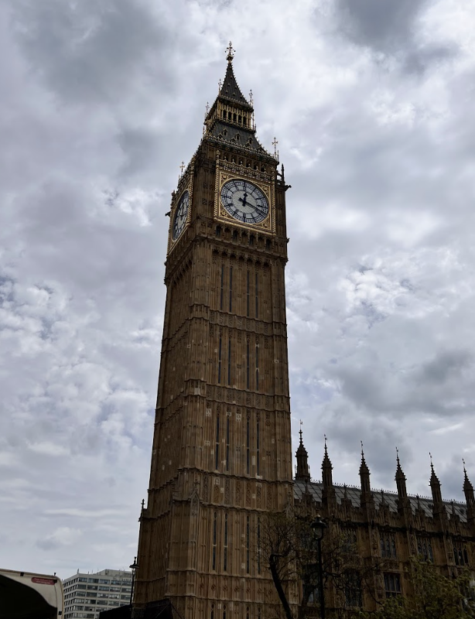
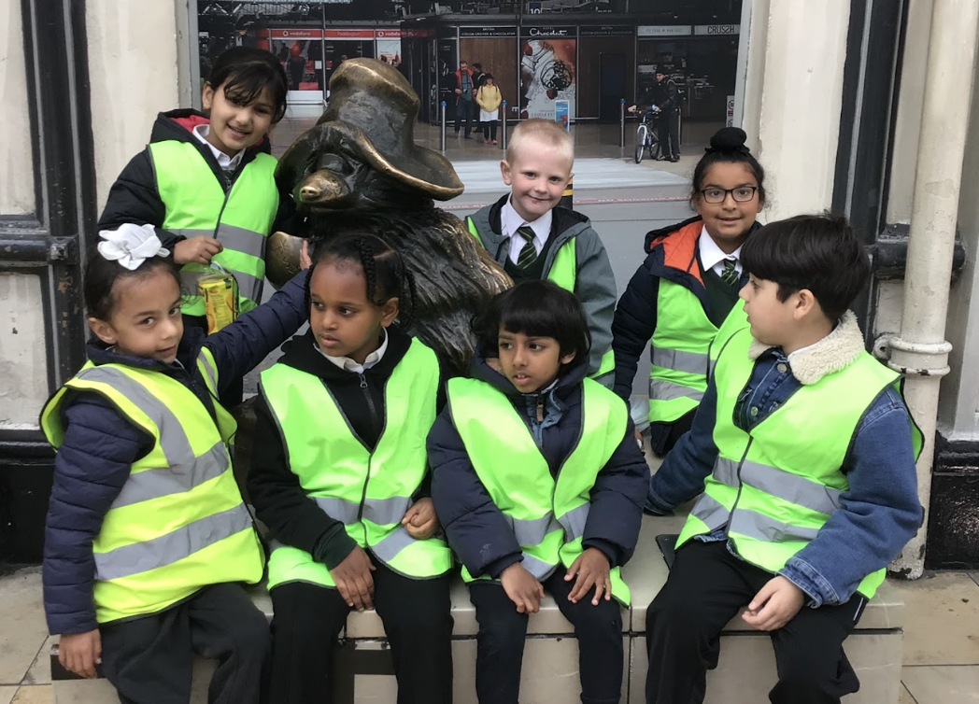
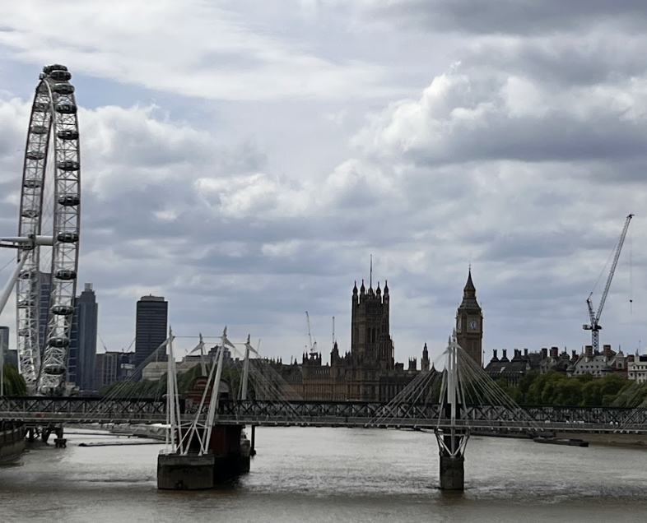
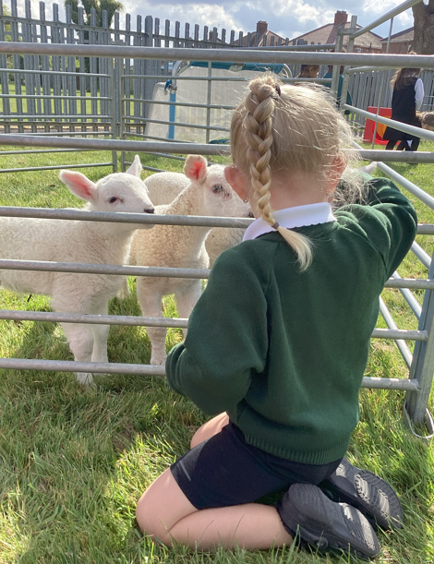
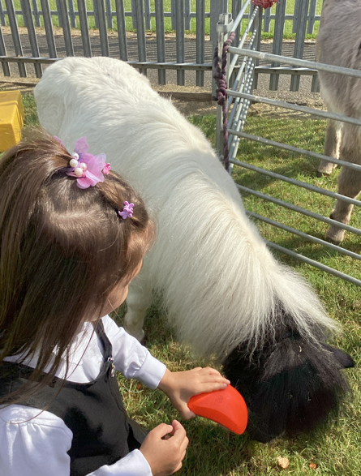
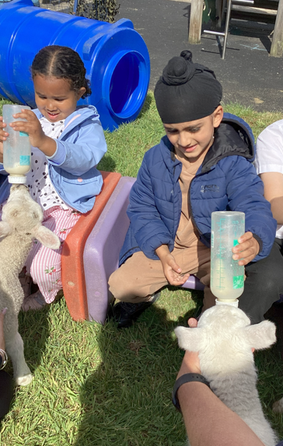
Year 1 London Bus Trip
On Tuesday, our Year 1 children had a fantastic trip to Paddington Station, where they enjoyed seeing the famous Paddington statue and deepening their understanding of transport as part of their History learning. This was followed by an exciting open-top bus tour around London. The children were exceptionally well behaved throughout the day and represented the school with pride. They showed great enthusiasm, eagerly spotting well-known landmarks such as Big Ben, Tower Bridge, and The Shard, among many others. It was wonderful to see how engaged and excited they were as they brought their classroom learning to life. This memorable experience has provided a strong foundation for their English work, where they will be writing detailed recounts of their journey using their observations and first-hand experiences.
Nursery Farm Visit
The Nursery children had a wonderful time yesterday when the farm came to visit the children. The children were excited to meet a variety of friendly animals and enjoyed a truly hands-on experience, learning how to gently care and interact with them. They had the opportunity to stroke, walk, hold, and even feed some of the animals, which helped build their confidence and curiosity about the natural world. There were lots of smiles, laughter, and excited conversations throughout the day, making it a memorable experience for everyone involved. The visit was a fantastic way to support the children’s learning about animals and life on the farm in a fun and engaging way.

Slide 3

CURRICULUM BOOKS / HOME LEARNING LETTERS
The curriculum booklets for the Summer term and the Home Learning Policy are on the website. Please follow the links to access them:-
https://www.charvilleacademy.org/page/?title=Curriculum+Booklets&pid=124&action=saved
Walk to School Week
Our school is taking part in Walk to School Week from Monday 18th- Friday 22nd May.
Each day pupils will learn about the important reasons to walk or wheel and its benefits for individuals, communities and the environment. By walking, cycling or scooting to school you’re helping our school reduce congestion and pollution around the school gates and encouraging healthy habits. Walking, wheeling, scooting and cycling all count. If you live far away from school and need to drive or take public transport, you could even try parking the car or hopping off the bus ten minutes away and walking the rest of the journey
Job vacancies
We currently have a vacancy for a Designated Attendance and Welfare Lead, please see the link below, which will direct you to Crinkle Recruitment.
https://crinklerecruitment.com/Job/Designated-Attendance-and-Welfare-Lead-6701
We currently have a vacancy for a Early Career Teacher, please see the link below, which will direct you to Crinkle Recruitment.
https://crinklerecruitment.com/Job/Early-Career-Teacher-ECT-6714

Slide 4

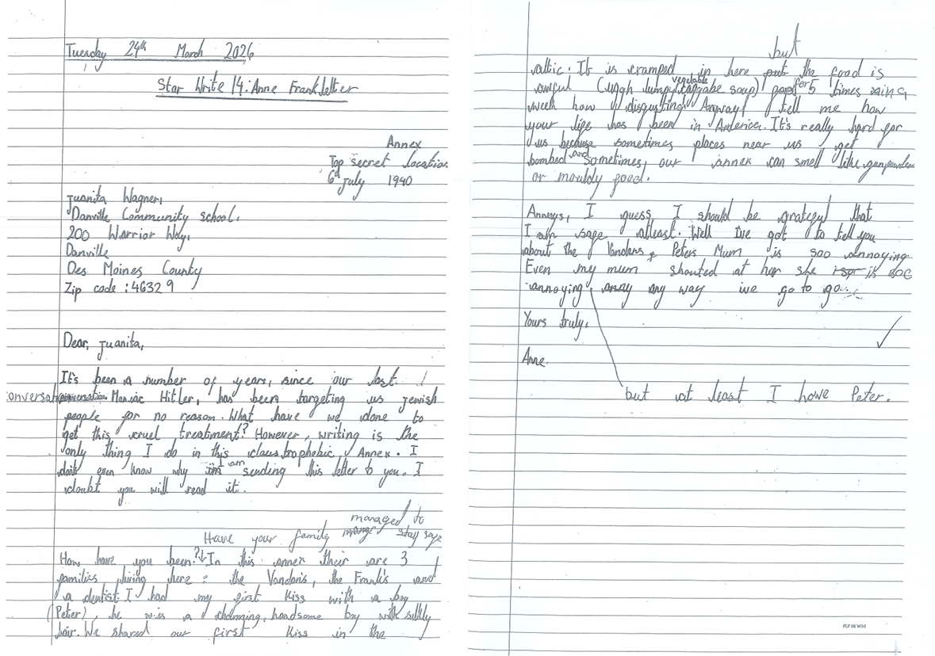
I Am A Clever Writer
Congratulations to Maira in Year 6 whose diary entry has been chosen for the board this week.

Slide 5
Performing Arts Summer Workshops at the Compass Theatre - now taking bookings!
Spend your summer holidays onstage at our popular musical theatre workshops for young people. Rehearse songs, drama scenes and dance routines from hit West End and Broadway musicals ready for two performances onstage on the Friday at 1:30 pm & 3 pm. Workshops run 10am-4pm each day and each week features different musicals - perfect for those eager stars who want to join us at both workshop weeks!
5 day workshops (7-16yrs): 27-31 July / 17-21 Aug
2 day workshops (4-6yrs): 30 & 31 July / 20 & 21 Aug
We can't wait for another summer of musical theatre creativity and your child's invited, so secure their place today.
For more information, please contact Hillingdon Theatres Box Office (boxoffice@hillingdon.gov.uk / 01895 250615) or book here.
Letters home
Holiday Club – Years 1-6
Walk To School Week – Whole school
Class Photo Day – Whole school
Attendance
Whole school attendance this week is 92.97%
Well done to 4C, 6B and 6D who had above 95%

Slide 6
Key Dates Summer Term
18th May – Discovery Centre Trip – Reception
20th May – PTA Fun Day – Whole school
21st May – Class Photo Day
22nd May – End of half term
25th-29th May - Half term
1st June – Pupils return to school
5th -8th June – PGL – Year 6
15th June – Nursery Sports Day
16th June- Reception & KS1 Sports Day
18th June – KS2 Sports Day
19th June – PTA School Discos
25th June - Science museum trip – Year 5
2nd July – Cinema & Bowling Trip – Year 6
9th July National Gallery Trip – Year 4
9^{th /} 10th July – Year 6 Production
16th July – Year 6 Leavers Assembly & Prom
17th July – End of summer term, school closes at 1.30pm

